Slide 1
CGA-GDC 2021
Current successes with incorporating emerging farmers in the export value chain

Slide 2
CGA Group Company Structure
Citrus Growers in South Africa,
Swaziland and Zimbabwe
Citrus Research Trust

Slide 3
SOUTH AFRICAN CITRUS INDUSTRY
Gross Value: R20 Billion (2019)
Citrus accounts for 40% of SA export citrus – largest fruit export commodity in the country
80 808 ha registered
2nd largest citrus producer in the world after Spain
Employs approximately 120 000 people
105 black owned entities – 9369 ha
Four main categories – orange, grapefruit, lemon and easy peelers/soft citrus
Oranges and grapefruit mainly grown in the warmer regions
Harvesting season runs from March to October

Slide 4
Evolution of the Grower Development Company
Year 2000
CGA established the Transformation desk- to drive transformation in the citrus Industry
Year 2010
Year 2013
CGA through the transformation desk conducted situational analysis on 118 black citrus growers- to look at support required
The Citrus Development Chamber was formed as a voice for black growers within the CGA structures and committees
Year 2016
The report resulted in a chamber requesting the establishment of a fully fleshed company to drive transformation.
CGA-GDC established.

Slide 5
PRIORITY AREAS
Good Agricultural Practises
Soil preparation
Irrigation
Infrastructure
Asset care & mgt.
Tree spacing and layout
Pest & disease control
Sanitation
Grower Supply Planning
Value Chain Enablers
Storage
Logistics
Marketing
Distribution
Harvesting schedules
Orchard replacement
Export oriented operations
Cultivar choice
Quality control and assurance
Certification – Global Gap; SIZA etc

Slide 6
CGA-GDC helps facilitate empowerment and development of black citrus producers through:
Technical and business management support
Enable growers to produce quality produce
Attract the best markets and best prices
Provision of Production infrastructure:
Achieving regulatory compliance
Accreditation
Irrigation
mechanization
infrastructure and
equipment
to meet the requirements of the different international markets

Slide 7
SUMMARY OF CITRUS FARMS IN THE CGA REGIONS
Province: | Total Farms | Ha Planted Citrus: | Bearing Citrus Trees (Ha); | Non-Bearing Citrus Trees (Ha): | New Entrants: | Available for Planting (Ha): | Vandalized/Non-Existing Farms:
Eastern Cape (EC) | 34 | 2170,59 | 1759,06 | 412 | 0 | 422.63 | 7
Gauteng (GP) | 1 | 32 | 32 | 0 | 0 | 40 | 1
Kwazulu Natal (KZN) | 7 | 747,7 | 557,1 | 190.6 | 0 | 800.8 | 8 (329ha)
Limpopo (L) | 36 | 4007 | 3345,9 | 661,1 | 3 | 2000 | 28 (1018ha)
Mpumalanga (MP) | 8 | 1072 | 1072 | 0 | 1 | 1420 | 8 (604ha)
North West (NW) | 6 | 90.5 | 80.5 | 10.5 | 4 | 203 | 0
Northern Cape (NC) | 4 | 861.3 | 861.3 | 0 | 0 | 0 | 0
Western Cape (WC) | 9 | 387 | 387 | 0 | 0 | 0 | 0
Totals | 105 | 9369 | 8094.86 | 1275 | 8 | 4906.43 | 52 Farms (1951ha)

Slide 8
SUCCESSES TO DATE
Production
Citrus ha under black ownership increased from 7211 in 2016 to 9 369 in 2020
Market performance
Black citrus growers have achieved a 40% increase in production during the 2019-2020 citrus season.
Ha of new orchards planted by black farmers since 2019 amount to 1 275- a 13,6 % increase in 1 year (2019)
supermarkets.
Several Black growers have increased output by over 40 000 cartons with one black grower increasing production by 99 000 cartons in just one year.
Locally, black citrus growers have increased output to domestic markets by 55% since 2019.
In 2020, black citrus growers provided over 400 000 cartons of fruit to South African grocery stores and
The number of exporting black farmers has increased from 50 in 2016 to 77 in 2020 farmers

Slide 9
UPCOMING INITIATIVES
Through the New Levy Period focus will be on
Enterprise development - Increase the ha under Black own Citrus farms
Increase export volumes
Assist black Growers with Compliance and Accreditation to Access other market opportunities
Skills Development and Good Agricultural Practise
Local Market Development

Slide 10
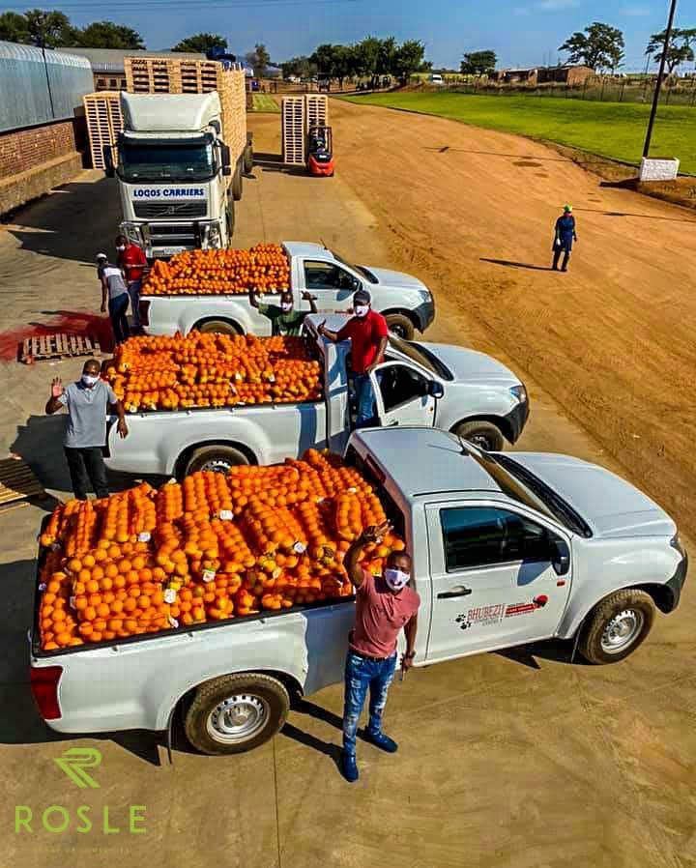
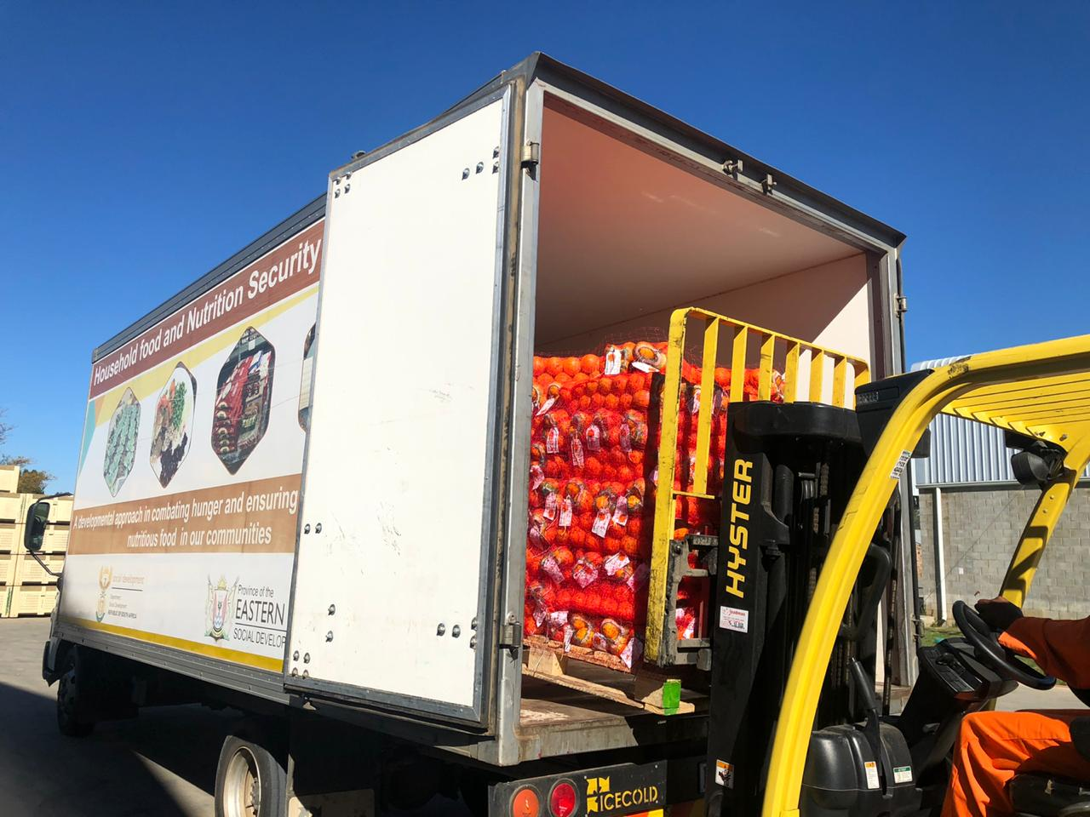
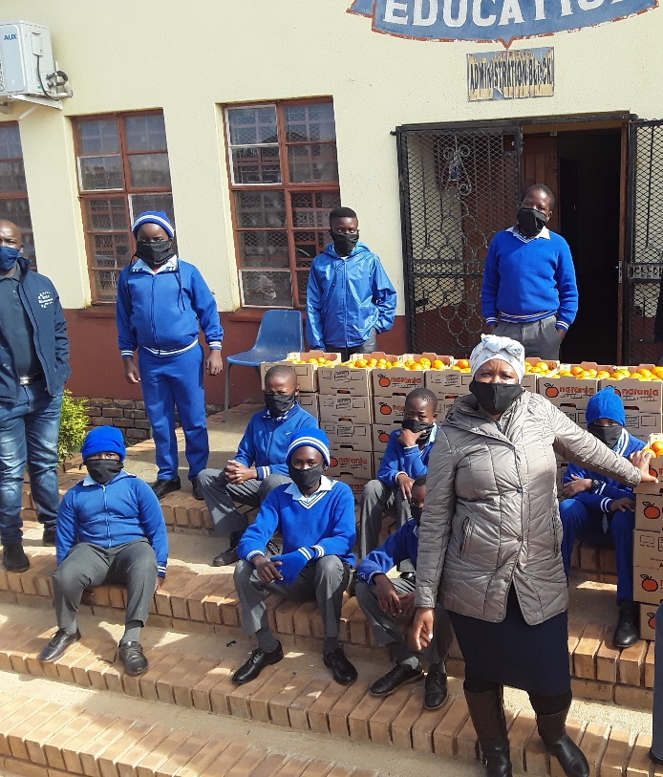
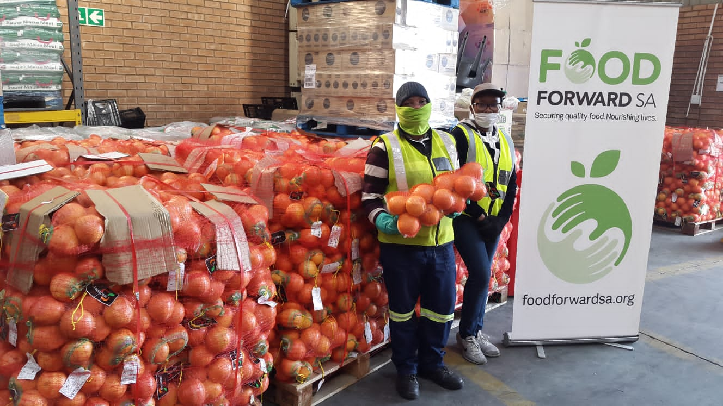
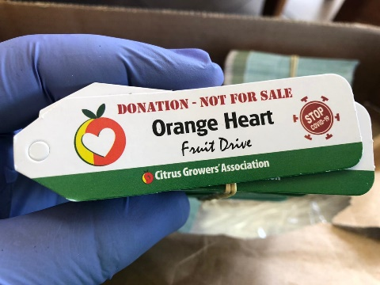
Orange heart fruit drive
OVER 1 500 TONNES CITRUS DONATED TO DATE

